Slide 1
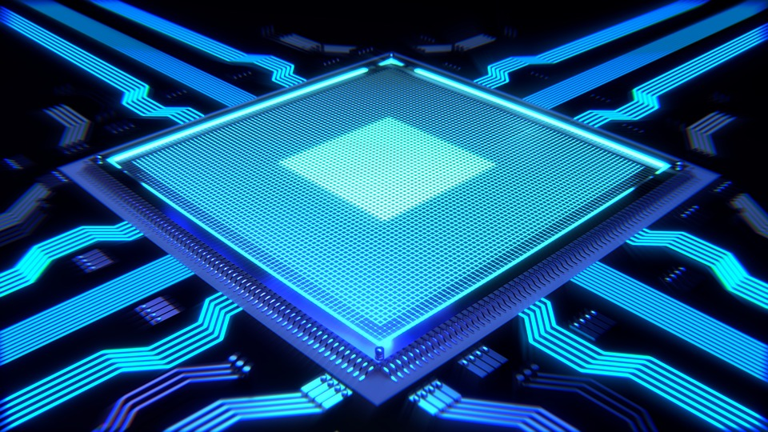

Computer-Aided Design Synthesis
Mahdi Aminian
Some slides courtesy of:
“Hardware Systems Modeling”, A. Vachoux, EPFL
CAD slides from Dr. Saheb Zamani

Slide 2
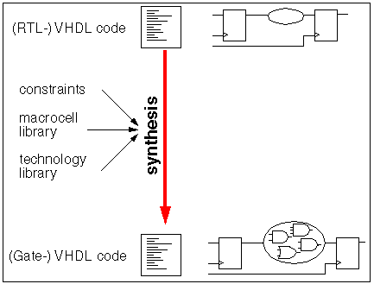
What is Synthesis?
Transformation of an abstract description into a more detailed description
"+" operator is transformed into a gate netlist
"if (VEC_A = VEC_B) then" → a comparator which controls a multiplexer
Transformation depends on several factors:
Algorithm, constraints, library
عملگرهاي ساده (مثل AND، OR، مقايسه) به گيتهاي مشخصي تبديل مي شوند اما عملگرهاي پيچيده تر مثل ضرب ابتدا به ماکروسلهاي خاص آن tool تبديل مي شوند.

Slide 3
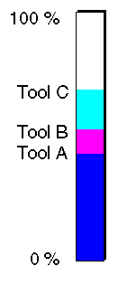
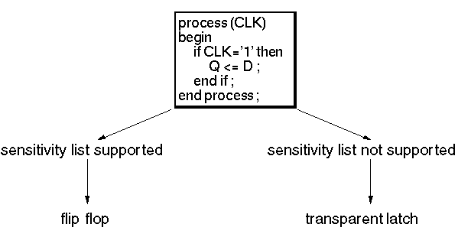
Synthesizability
Only a subset of VHDL is synthesizable
Different Tools support different subsets
records?
arrays of integers?
clock edge detection?
sensitivity list?
...
Different Language Support for Synthesis

Slide 4
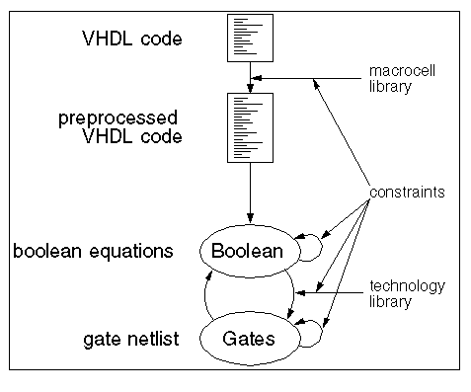
How to Do?
Macrocells
adder
comparator
bus interface
counter
Constraints
speed
area
power
Optimizations
boolean: mathematic
LUTs: technological

Slide 5
Constraints
محدوديتهاي سخت: محدوديتهاي ثابتي که در سنتزکننده وجود دارد:
مربوط به محدوديتهاي target technology (مثل محدوديت fanout در Logic Blockها)
و مربوط به توانايي tool
محدوديتهاي نرم: محدوديتهايي که کاربر مشخص مي کند:
مثل حداقل سرعت لازم

Slide 6
Non-functional requirements
Performance:
Clock speed is generally a primary requirement.
Usually expressed as a lower bound.
Design cycle and Timing Closure
Size:
Determines manufacturing cost.
If your design doesn’t fit into one size FPGA, you must use the next larger FPGA.
For very large designs: multi-FPGAs.
Power/energy:
Power/Energy related to battery life and heat.
May have more cost:
More expensive packaging to dissipate heat.
More extreme measures (e.g. cooling fans).
Many digital systems are power- or energy-limited.

Slide 7
Mapping into an FPGA
Must choose the FPGA:
Capacity.
Pinout/package type.
Maximum speed.
Essential Information for Synthesis
Load values
Path delays
Driver strengths
Timing
Operating conditions (e.g. temperature)

Slide 8
Synthesis Process in Practice
باوجود مکانيزمهاي بهينه سازي، ممکن است بعد از سنتز، همة محدوديتها برآورده نشده باشند ← تکرار
Arch’re Design
yes
Design Entry
Synthesis
Results OK?
no
Alter Constraints
Alter VHDL Code
Alter Arch’re

Slide 9
Problems with Synthesis Tools
Timing issues
layout information is missing during the synthesis process
clock tree must be generated afterwards
Complex clocking schemes (inverted clocks, multiple clocks, gated clocks)
Memory
synthesis tools are not able to replace register arrays with memory macro cells
Macro cells
no standardized way for instantiation of existing technology macro cells

Slide 10
Synthesis Strategy
Consider the effects of different coding styles on the inferred hardware structures
Appropriate design partitioning
critical paths should not be distributed to several synthesis blocks
different optimization constraints may be used for separate blocks
Delay and Power Optimization
Combinational network delay
Combinational network energy/power

Slide 11
Delay characteristics
Measured from change in inputs to change in outputs.
Data-dependent:
Some block delays depend on the value/waveform at the input (t_{pHL} ≠ t_{pLH}) (t_{r} ≠ t_{f})
May need to observe different paths through the network.
A
B
time

Slide 12
Sources of Delay
Gate delay:
Little we can do about it
E.g. select another FPGA with faster logic blocks (LBs) or
Minimize the number of LBs in the critical path
Wire delay:
Much we can do
E.g. select the proper path of the wire or
Select buffered paths.
Two types:
lumped load (for short wires which are modeled by a single capacitance)
Little we can do.
transmission line (for long wires).

Slide 13
Fanout
Fanout adds capacitance.
Adding gates adds capacitance:
sink
source
sink
sink

Slide 14
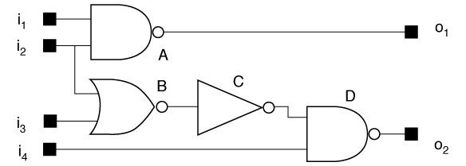
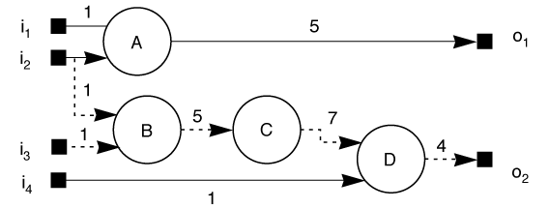
Path delay
Combinational network delay is measured over paths through network.
Can trace a causality chain from inputs to worst-case output.
network
graph model

Slide 15
Critical path
Critical path = path which creates longest delay.
Can trace transitions which cause delays that are elements of the critical delay path.

Slide 16
Delay model
Nodes represent gates.
Assign delays to edges—signal may have different delay to different sinks.
Lump gate and wire delay into a single value.

Slide 17
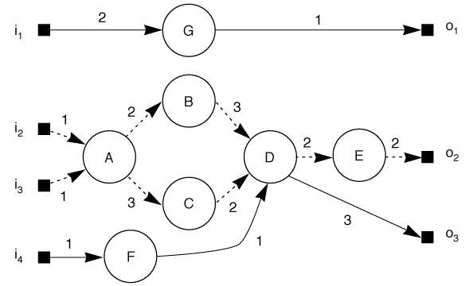
Critical path through delay graph

Slide 18
Reducing critical path length
Must speed up the critical path
Reducing delay off the path doesn’t help.
There may be more than one path of the same delay.
→ Must speed up all equivalent paths to speed up circuit.
Cutset: a set of edges that when removed, break the graph into two unconnected paths. (e.g. {(C,D), (B,D)} or {(D,E} )
Must speed up cutset through critical path.

Slide 19
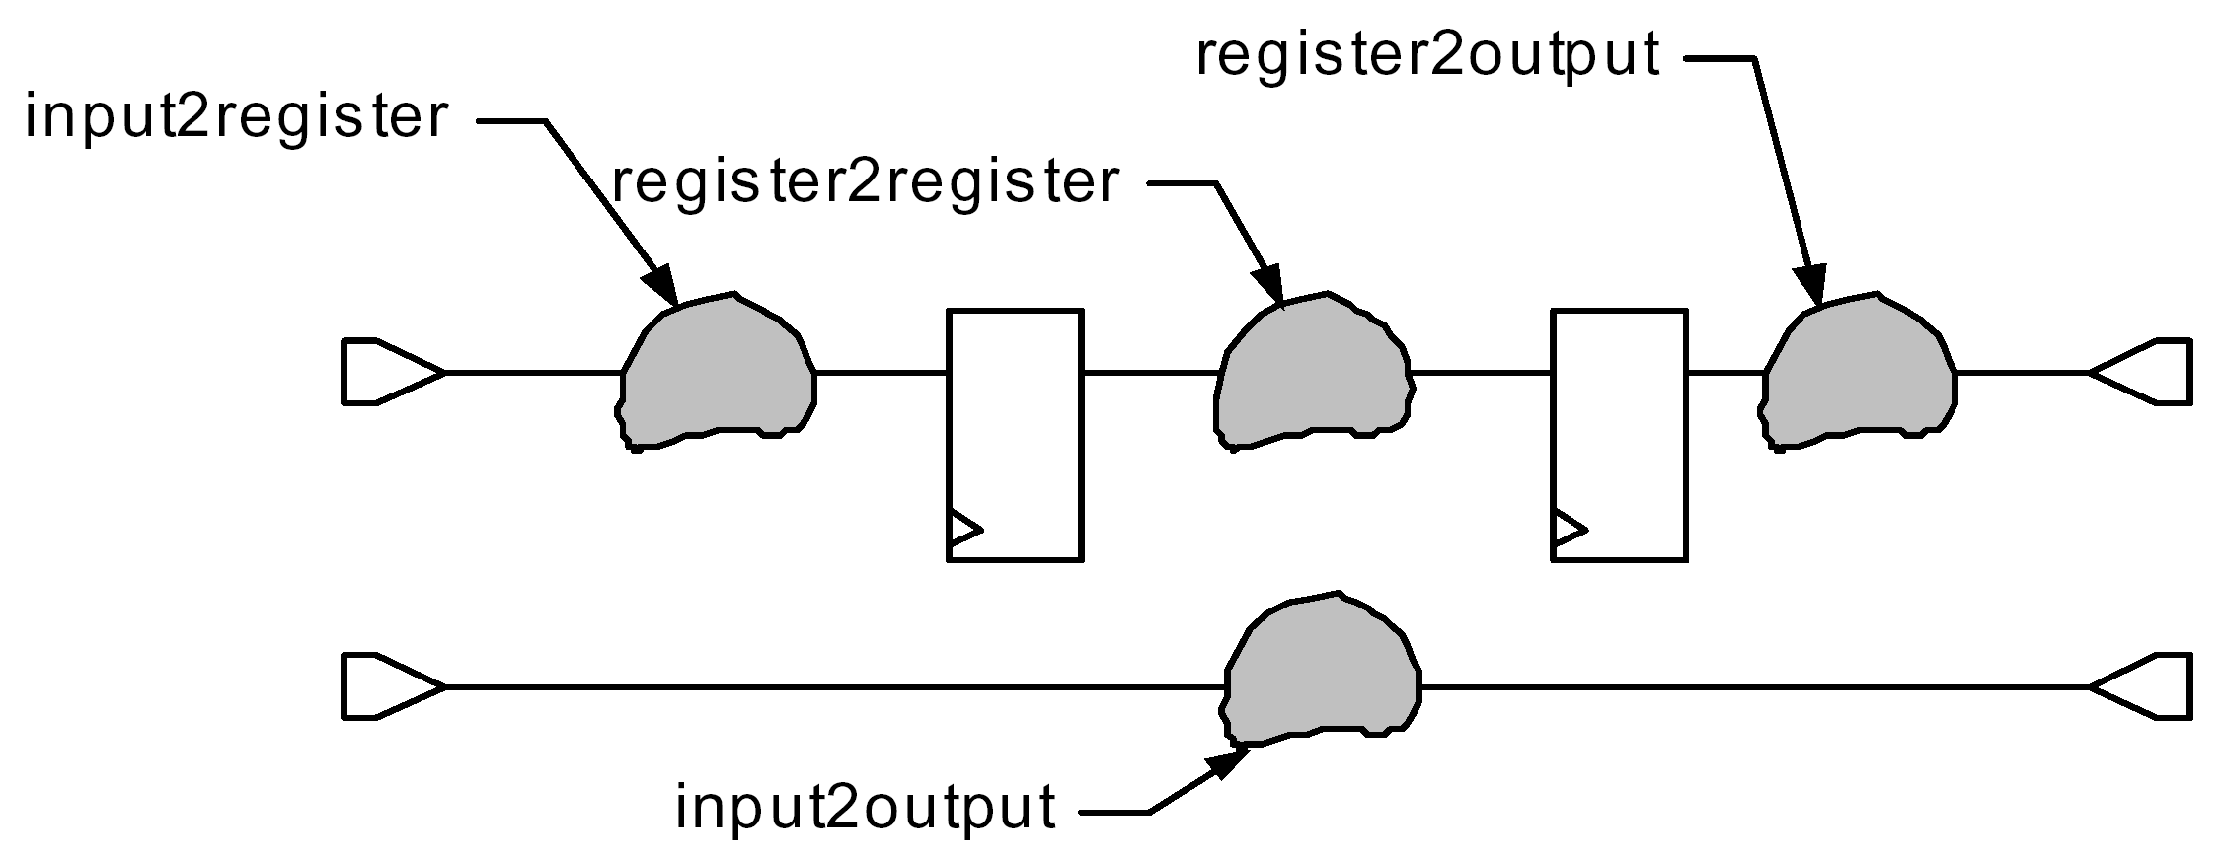
Delay Paths in a design

Slide 20
False paths
Some input changes don’t cause output changes.
A false path is a path which never happens due to Boolean gate conditions.
False paths cause pessimistic delay estimates.
δ = 10
δ = 10
δ = 20
δ = 20
False path

Slide 21
Placement and delay
Placement helps determine gate distances.
Gate distances determine routing.
Routing determines wire length.
Wire length determines capacitive load.
Capacitive load determines delay.
g1
g3
g1
g3
dvr
dvr
g2
g4
g2
g4

Slide 22
Optimizing network delay
Identify the longest path(s).
Improve delay along the longest path(s):
Driver delay
Wire delay
Logic restructuring

Slide 23
Example: Adder placement and delay
N-bit adder: (optimal placement)
+
+
+
+

Slide 24
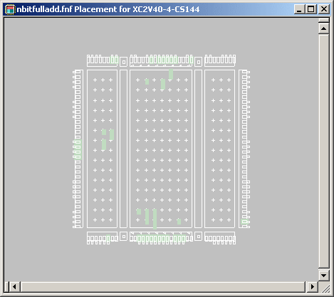
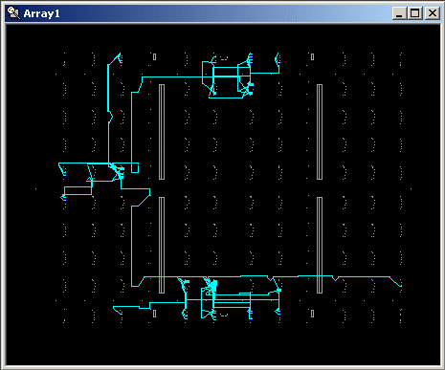
Bad placement and routing
With no delay constraints.
placement
routing
Adder has been distributed throughout the FPGA.
I/O pins have been spread around the chip.
→ P&R algorithms do not catch on to regularity.

Slide 25
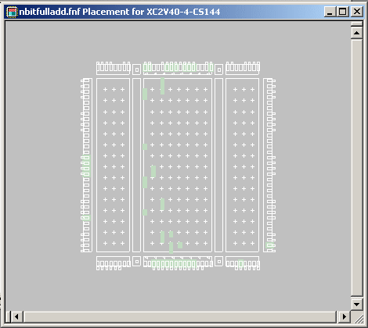
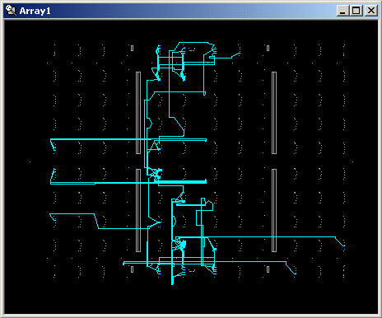
Better placement and routing
With delay constraints.
Better but far from optimal (less spread out horizontally but spread out vertically)

Slide 26
How to improve?
Use macros (optimized),
Put constraints on the placement of objects,
Hand place objects

Slide 27
The FPGA design process
Xilinx ISE (Integrated Synthesis Environment)
Translation from HDL
Logic synthesis
Placement and routing
Configuration generation

Slide 28
Design experiments
Synthesize with no constraints.
Synthesize with timing constraint.
Tighten timing constraint.
Synthesize with placement constraints.
Power:
Many tools don’t allow us to directly specify power consumption
Some tools allow us to specify power as an objective
May need to rewrite our h/w description for better power consumption characteristics.

Slide 29
Commercial Tools
XST “-power” option reduces dynamic power consumption.
Xilinx MAP and PAR“-power” option reduces dynamic power
But increases runtime and decreases design performance.
Quartus-II has Power-Driven Synthesis and Place & Route.

Slide 30
Post-translation simulation model
No timing or area constraints
HDL model in terms of FPGA primitives.
Example:
X_LUT4 \p12_Madd__n0015_Mxor_Result_Xo<1>1 (
.ADR0(x_7_IBUF),
.ADR1(y_13_IBUF),
.ADR2(c12[7]),
.ADR3(row12[8]),
.O(row13[7])
);

Slide 31
Mapping report
Design Summary
--------------
Number of errors: 0
Number of warnings: 0
Logic Utilization:
Number of 4 input LUTs: 501 out of 1,024 48%
Logic Distribution:
Number of occupied Slices: 255 out of 512 49%
Number of Slices containing only related logic: 255 out of 255 100%
Number of Slices containing unrelated logic: 0 out of 255 0%
*See NOTES below for an explanation of the effects of unrelated logic
Total Number 4 input LUTs: 501 out of 1,024 48%
Number of bonded IOBs: 64 out of 92 69%
Total equivalent gate count for design: 3,006
Additional JTAG gate count for IOBs: 3,072
Peak Memory Usage: 64 MB

Slide 32
Static timing analysis report
Timing constraint: TS_P2P = MAXDELAY FROM TIMEGRP "PADS" TO TIMEGRP "PADS" 99.999 uS ;
20135312 items analyzed, 0 timing errors detected. (0 setup errors, 0 hold errors)
Maximum delay is 20.916ns.
--------------------------------------------------------------------------------
After Mapping: → estimated delays (no information about interconnects)

Slide 33
Static timing report: delays along paths
Data Sheet report:
-----------------
All values displayed in nanoseconds (ns)
Pad to Pad
------------------+----------------------+-----------+
Source Pad |Destination Pad| Delay |
------------------+----------------------+-----------+
x<0> |p<0> | 5.824|
x<0> |p<10> | 10.675|
x<0> |p<11> | 11.214|
x<0> |p<12> | 11.753|

Slide 34
Routing report
Phase 1: 1975 unrouted; REAL time: 11 secs
Phase 2: 1975 unrouted; REAL time: 11 secs
Phase 3: 619 unrouted; REAL time: 12 secs
Phase 4: 619 unrouted; (0) REAL time: 12 secs
Phase 5: 619 unrouted; (0) REAL time: 12 secs
Phase 6: 619 unrouted; (0) REAL time: 12 secs
Phase 7: 0 unrouted; (0) REAL time: 12 secs
The NUMBER OF SIGNALS NOT COMPLETELY ROUTED for this design is: 0
REAL time: Routing algorithm run time.

Slide 35
Static timing after routing
Timing constraint: TS_P2P = MAXDELAY FROM TIMEGRP "PADS" TO TIMEGRP "PADS" 99.999 uS ;
20135312 items analyzed, 0 timing errors detected. (0 setup errors, 0 hold errors)
Maximum delay is 38.424ns.
-------------------------------------------------------------------
(vs. 20.916 ns in mapping report) Because of interconnect delays.

Slide 36
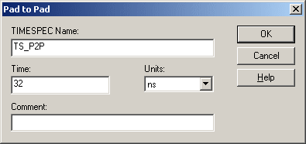
Timing constraint
Use timing constraint editor:

Slide 37
Post-routing static timing report
Timing constraint: TS_P2P = MAXDELAY FROM TIMEGRP "PADS" TO TIMEGRP "PADS" 32 nS ;
20135312 items analyzed, 0 timing errors detected. (0 setup errors, 0 hold errors)
Maximum delay is 31.984ns.
Tools generally try to meet the delay goal as closely as possible to minimize area.

Slide 38
Tighter timing constraints
Tighten requirement to 25 ns.
Post-place-route timing report:
Timing constraint: TS_P2P = MAXDELAY FROM TIMEGRP "PADS" TO TIMEGRP "PADS" 25 nS ;
20135312 items analyzed, 11 timing errors detected. (11 setup errors, 0 hold errors)
Maximum delay is 31.128ns.

Slide 39
Report on a violated path
Slack: -6.128ns (requirement - data path)
Source: y<0> (PAD)
Destination: p<30> (PAD)
Requirement: 25.000ns
Data Path Delay: 31.128ns (Levels of Logic = 31)
Modify the logic and/or physical design to improve the delay.

Slide 40
Power report
Power summary: I(mA) P(mW)
----------------------------------------------------------------
Total estimated power consumption: 333
---
Vccint 1.50V: 0 0
Vccaux 3.30V: 100 330
Vcco33 3.30V: 1 3
---
Inputs: 0 0
Logic: 0 0
Outputs:
Vcco33 0 0
Signals: 0 0
---
Quiescent Vccaux 3.30V: 100 330
Quiescent Vcco33 3.30V: 1 3
Thermal summary:
----------------------------------------------------------------
Estimated junction temperature: 36C
Ambient temp: 25C
Case temp: 35C
Theta J-A: 34C/W
Helps us determine whether we need additional cooling.

Slide 41
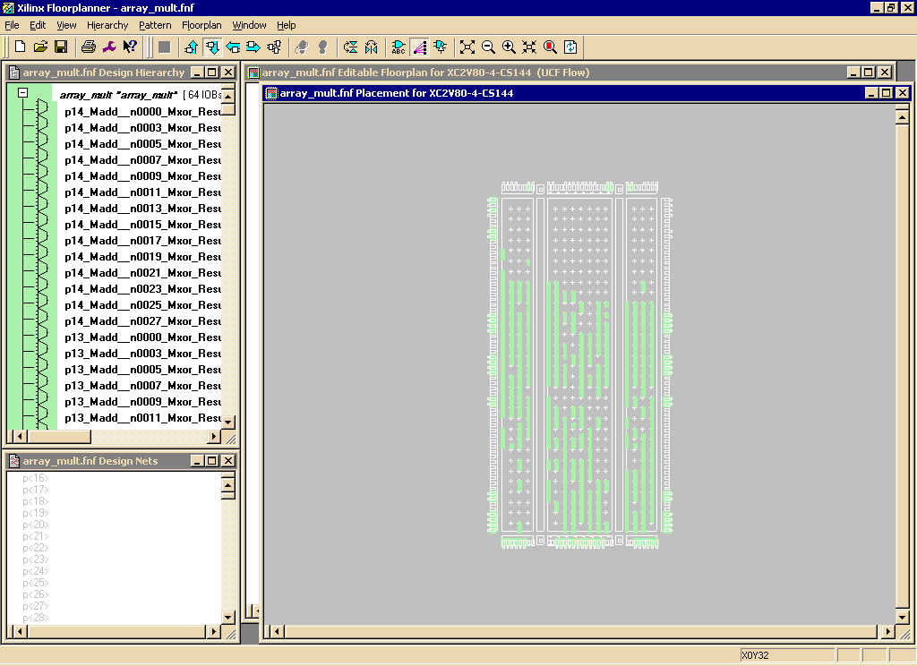
Improving area
Floorplanner window:
Floorplanner → View/edit placed design
Chip
floorplan
LEs
Green rectangles: mapped components to CLBs

Slide 42
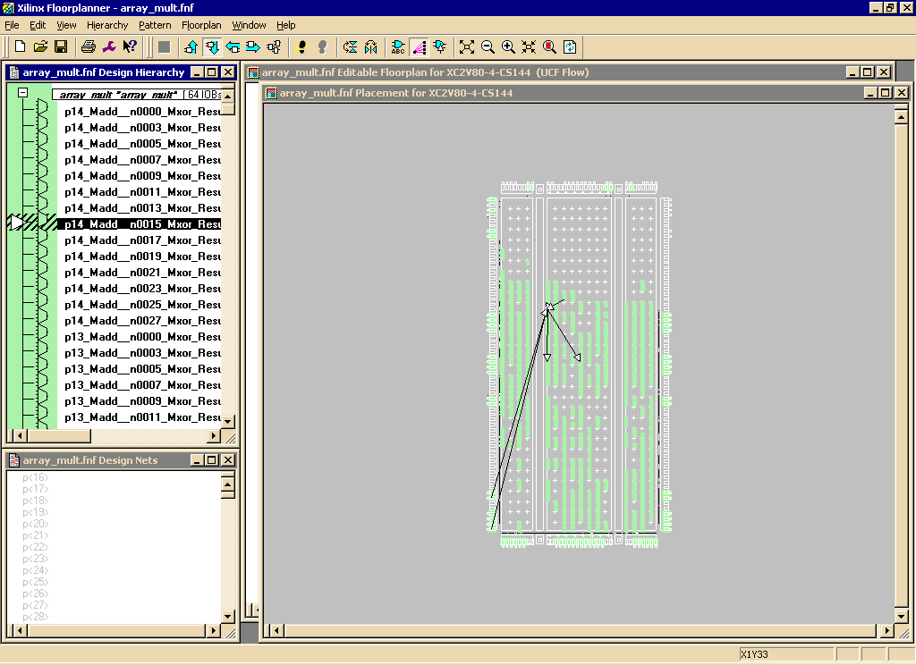
Rat’s nest wiring
If you click on a component in the deign hierarchy window, its rat’s nest is shown.

Slide 43
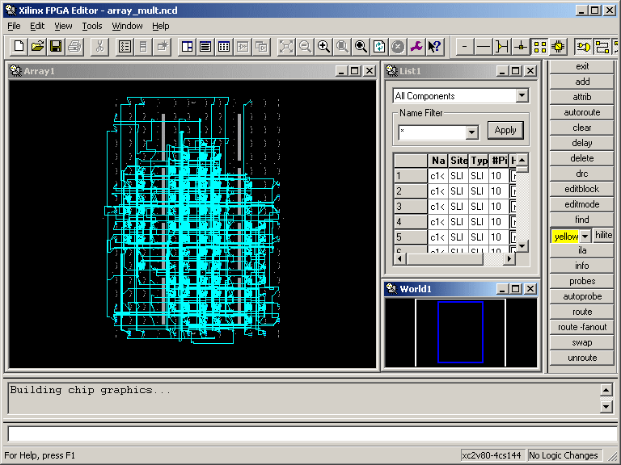
Routing editor view
FPGA Editor → View/Edit Routed Design

Slide 44
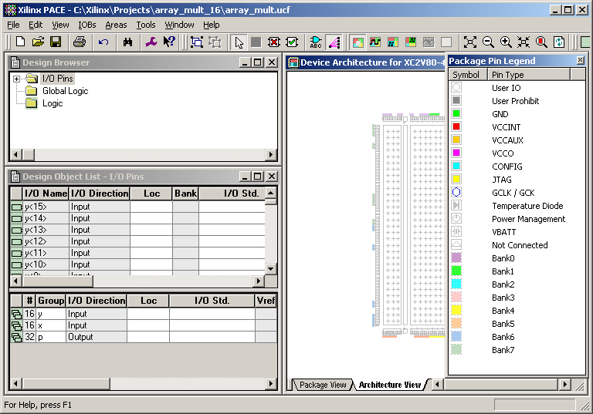
Editing constraints
Use constraints editor to place constraints:
This tool allws you to constrain
placement of logic
assignment of chip I/Os to IOBs (e.g useful for PCB design)

Slide 45
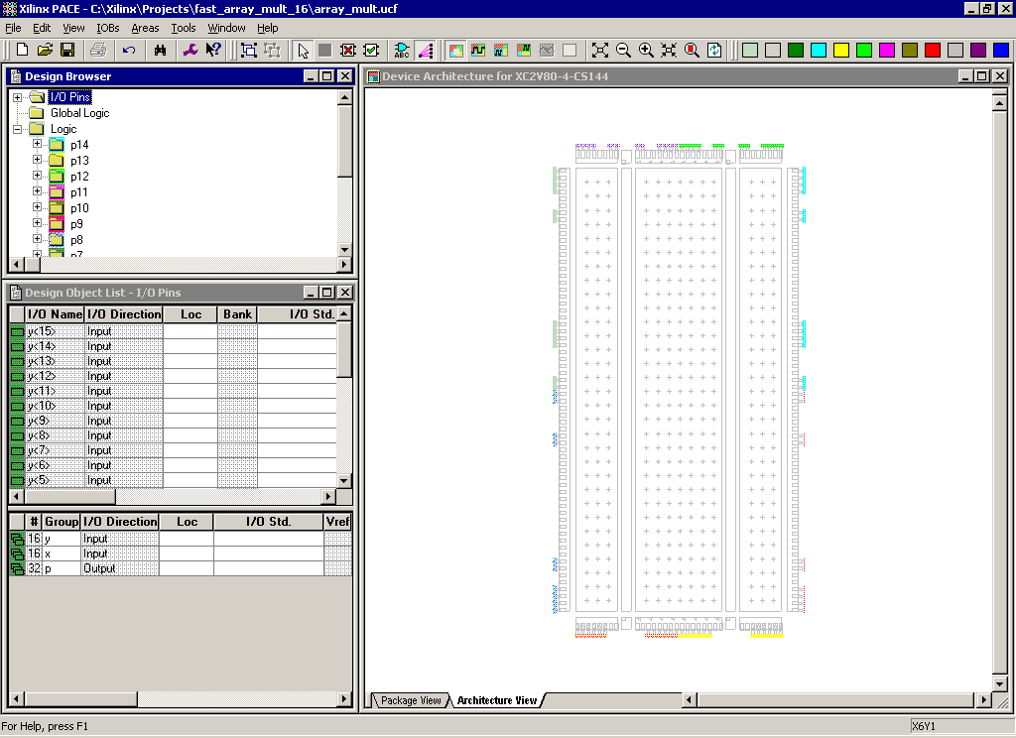
Design browser pane

Slide 46
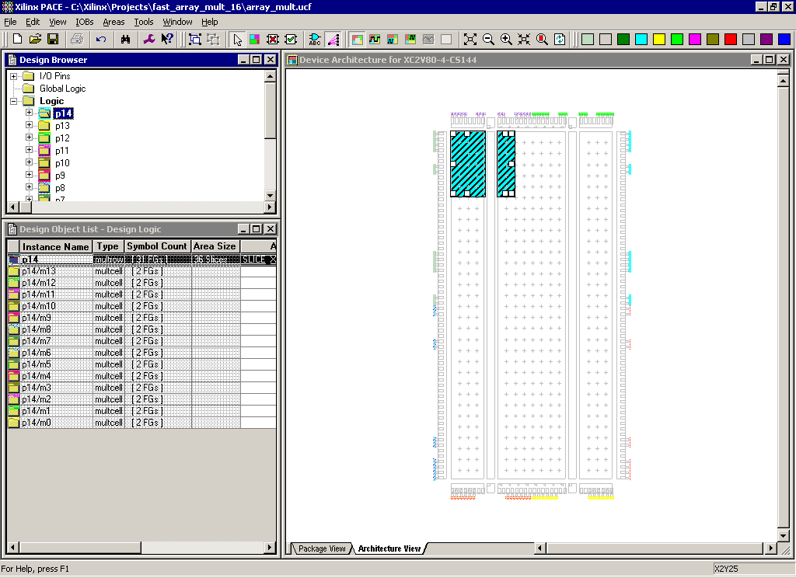
Drag and drop constraints

Slide 47
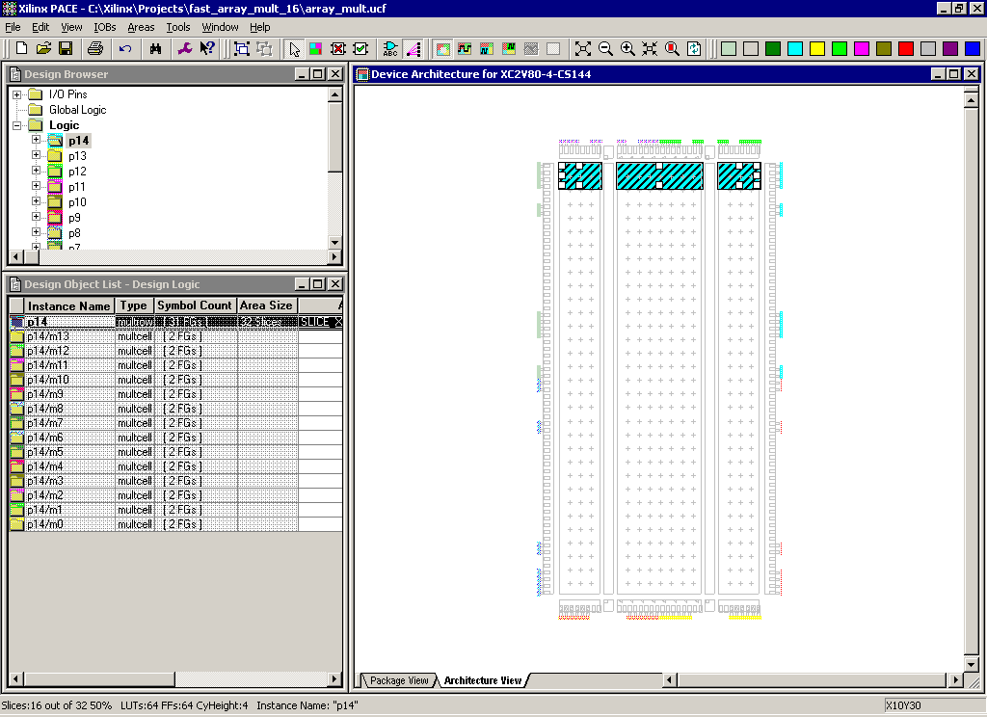
Change the shape of constraints

Slide 48
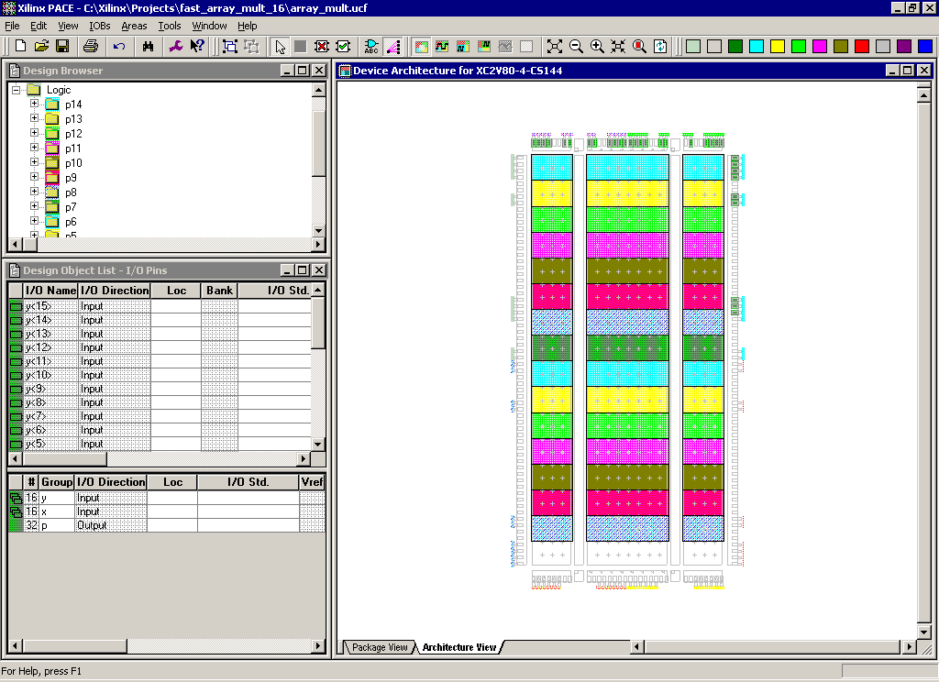
Full set of placement constraints
We place the rows of the multiplier one below the other to create the row structure of the floorplan.

Slide 49
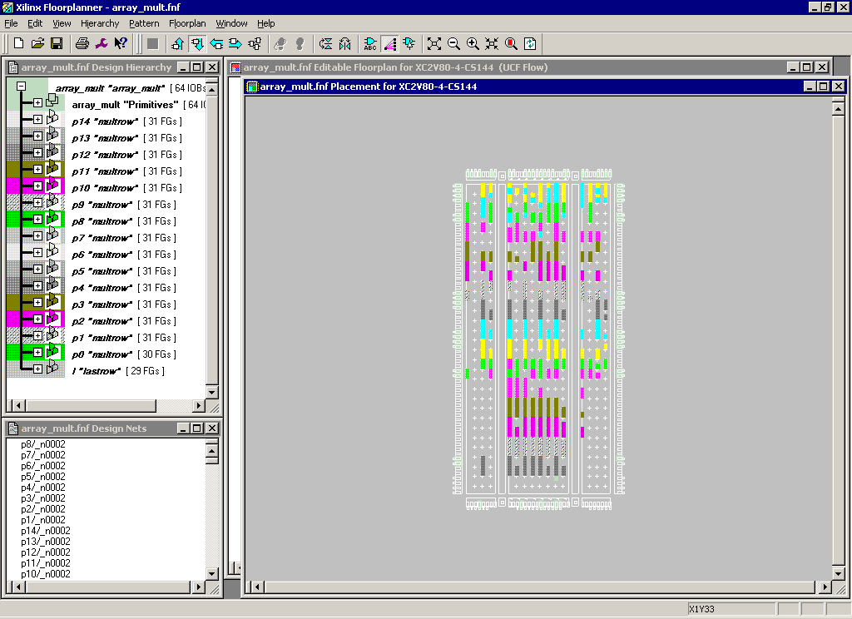
Placement results

Slide 50
New timing report
After placement constraints:
19742142 items analyzed, 0 timing errors detected. (0 setup errors, 0 hold errors)
Maximum delay is 29.934ns.
Compares to 31.128 ns for unconstrained placement.

Slide 51
Power Optimization

Slide 52
Power optimization
Transitions cause power consumption.
Logic network design helps control power consumption:
minimizing capacitance;
eliminating unnecessary glitches.
P_{dyn}= ∑a.f.C_{L}.V_{dd}²

Slide 53
Power estimation tools
Power estimator approximates power consumption from:
Netlist;
Primary input transition probabilities;
Capacitive loading.
Two Types:
Switch/logic simulation-based
Statistical models

Slide 54
Power optimization
Leakage in more advanced processes.
Even when logic is idle.
Solution:
Reducing junction temperature by using fans, heat sinks, or design modifications
Reducing voltage levels of the IOs.
Each bank requires a separate power supply.

Slide 55
Power optimization
Maximizing the number of unused and unpowered banks.
Clock gating:
Clocks that drive logic, embedded memory, SerDes, and other FPGA primitives can be disabled when their operation is not required.

Slide 56
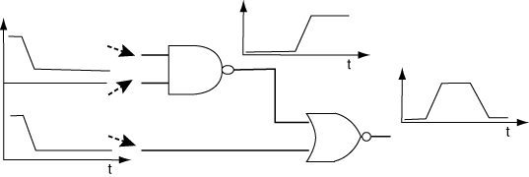
Glitching example
Gate network:

Slide 57
Glitching example behavior
NOR gate produces 0 output at beginning and end:
beginning: bottom input is 1;
end: NAND output is 1;
Difference in delay between application of primary inputs and generation of new NAND output causes glitch.

Slide 58
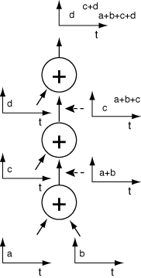
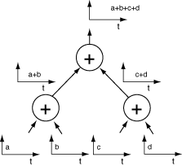
Adder Chain Glitching
a+b+c+d
c+d
d
a+b+c
a+b+c
c
a+b
a+b
a+b
good
bad

Slide 59
Explanation
Unbalanced chain has signals arriving at different times at each adder.
A glitch downstream propagates all the way upstream.
Balanced tree introduces multiple glitches simultaneously, reducing total glitch activity.

Slide 60
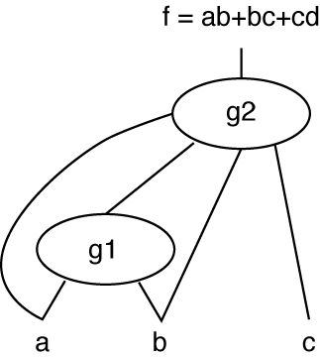
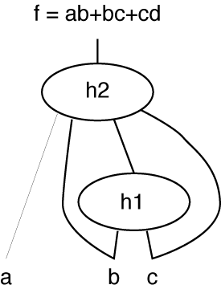
Factorization for low power
Proper factorization reduces glitching.
‘a’ has high transition probability, ‘b’ and ‘c’ low probabilities
f(a, b, c)
f(a, b, c)
bad
good

Slide 61
Factorization techniques
Reduce number of logic levels through which high-probability signals must travel
→ Reduce propagation of glitches.

Slide 62
Example (ALU)
ALU output is not used for every cycle
→ If ALU inputs change, the energy is needlessly consumed

Slide 63
Example (ALU)
Control Signal selects whether data is allowed to pass the logic or the previous value is held to avoid transitions.
Data
Logic
D
Q
Control

Slide 64
Low Power Design Techniques
Reduce wiring capacitance
Get post-layout feedback for better capacitance estimations
Place and route to minimize capacitance of nodes with high glitching activity.
Reducing FPGA operating voltages.
Reducing operating frequencies.
Reducing the overall toggle rate of the design.

Slide 65
State assignment
One-hot:
usually a good choice for optimizing speed or reducing power.
Gray:
appropriate for controllers exhibiting long paths without branching.
Minimizes hazards and glitches.
Gives good results when implementing the State Register with T Flip-Flops.
Can be used to minimize power
Compact:
Minimizes the number of bits in the state register.
Minimizes next state equations.

Slide 66
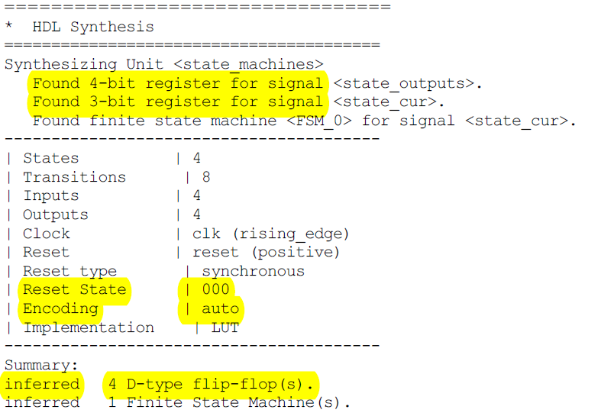
Sample Report

Slide 67
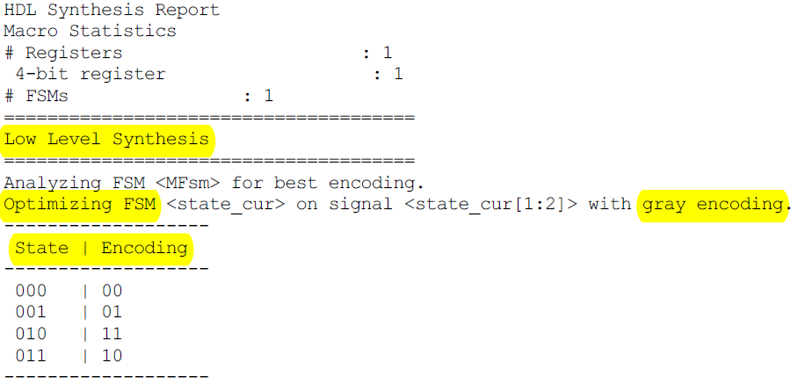
Changed to gray automatically

